Slide 1
Genetic Algorithms (GA) OVERVIEW
A class of probabilistic optimization algorithms
Inspired by the biological evolution process
Uses concepts of “Natural Selection” and “Genetic Inheritance” (Darwin 1859)
Originally developed by John Holland (1975)

Slide 2
GA overview (cont)
Particularly well suited for hard problems where little is known about the underlying search space
Widely-used in business, science and engineering

Slide 3
Classes of Search Techniques
Search Techniqes
Calculus Base Techniqes
Guided random search techniqes
Enumerative Techniqes
Fibonacci
Sort
Dynamic Programming
BFS
DFS
Tabu Search
Simulated Anealing
Evolutionary Algorithms
Hill Climbing
Genetic Programming
Genetic Algorithms

Slide 4
A genetic algorithm maintains a population of candidate solutions for the problem at hand, and makes it evolve by iteratively applying a set of stochastic operators

Slide 5
Stochastic operators
Selection replicates the most successful solutions found in a population at a rate proportional to their relative quality
Recombination decomposes two distinct solutions and then randomly mixes their parts to form novel solutions
Mutation randomly perturbs a candidate solution

Slide 6
The Metaphor
Nature | Genetic Algorithm
Environment | Optimization problem
Individuals living in that environment | Feasible solutions
Individual’s degree of adaptation to its surrounding environment | Solutions quality (fitness function)

Slide 7
The Metaphor (cont)
Nature | Genetic Algorithm
A population of organisms (species) | A set of feasible solutions
Selection, recombination and mutation in nature’s evolutionary process | Stochastic operators
Evolution of populations to suit their environment | Iteratively applying a set of stochastic operators on a set of feasible solutions

Slide 8
The Metaphor (cont)
The computer model introduces simplifications (relative to the real biological mechanisms),
BUT
surprisingly complex and interesting structures have emerged out of evolutionary algorithms

Slide 9
Simple Genetic Algorithm
produce an initial population of individuals
evaluate the fitness of all individuals
while termination condition not met do
select fitter individuals for reproduction
recombine between individuals
mutate individuals
evaluate the fitness of the modified individuals
generate a new population
End while

Slide 10
The Evolutionary Cycle
parents
selection
modification
modified
offspring
initiate &
population
evaluation
evaluate
evaluated offspring
deleted
members
discard

Slide 11
Genetic Algorithms
A genetic algorithm (or GA) is a variant of stochastic beam search in which successor states are generated by combining two parent states, rather than by modifying a single state.
The analogy to natural selection is the same as in stochastic beam search, except now we are dealing with sexual rather than asexual reproduction.
Like beam search, GAS begin with a set of k randomly generated states, called the population.

Slide 12
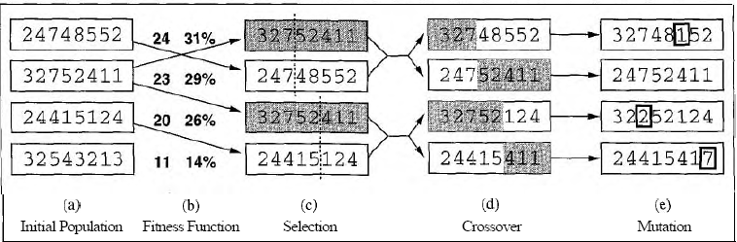
Genetic Algorithms
Figure 4.15 The genetic algorithm. The initial population in (a) is ranked by the fitness
function in (b), resulting in pairs for mating in (c). They produce offspring in (d), which are subject to mutation in (e).
Each state, or individual, is represented as a string over a finite alphabet-most commonly, a string of 0s and 1s.

Slide 13
Genetic Algorithms
The production of the next generation of states is shown in Figure 4.15(b)-(e).
In (b), each state is rated by the evaluation function or (in C;A terminology) the fitness function.
A fitness function should return higher values for better states, so, for the 8-queens problem we use the number of non attacking pairs of queens, which has a value of 28 for a solution.
The values of the four states are 24, 23, 20, and 11. I in this particular variant of the genetic
algorithm, ithe probability of being chosen for reproducing is directly proportional to the
fitness score, and the percentages are shown next to the raw score
In (c), a random choice of two pairs is selected for reproduction, in accordance with the
probabilities in (b). Notice that one individual is selected twice and one not at all.
For each pair to be mated, a crossover point is randomly chosen from the positions in the string. In Figure 4.15 the crossover points are after the third digit in the first pair and after the fifth digit in the second pair
In (d), the offspring themselves are created by crossing over the parent strings at the
crossover point. For example, the first child of the first pair gets the first three digits from the first parent and the remaining digits from the second parent, whereas the second child gets the first three digits from the second parent and the rest from the first parent

Slide 14
Genetic Algorithms
Finally, in (e), each location is subject to random mutation with a small independent probability.
One digit was mutated in the first, third, and fourth offspring. In the 8-queens problem, this corresponds to choosing a queen at random and moving it to a random square in its column.
Figure 4.17 describes an algorithm that implements all these steps.

Slide 15
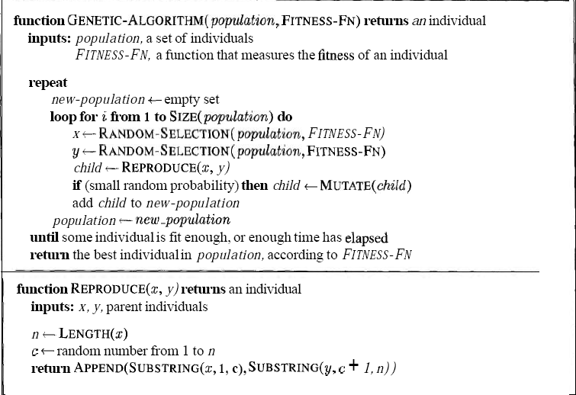
Genetic Algorithms
Figure 4.17 : A genetic algorithm. The algorithm is; the same as the one diagrammed in
Figure 4.15, with one variation: in this more popular version, each mating of two parents
produces only one offspring, not two

Slide 16
Example: the MAXONE problem
Suppose we want to maximize the number of ones in a string of l binary digits
Is it a trivial problem?
It may seem so because we know the answer in advance
However, we can think of it as maximizing the number of correct answers, each encoded by 1, to l yes/no difficult questions`

Slide 17
Example (cont)
An individual is encoded (naturally) as a string of l binary digits
The fitness f of a candidate solution to the MAXONE problem is the number of ones in its genetic code
We start with a population of n random strings. Suppose that l = 10 and n = 6

Slide 18
Example (initialization)
We toss a fair coin 60 times and get the following initial population:
s₁ = 1111010101 f (s₁) = 7
s₂ = 0111000101 f (s₂) = 5
s₃ = 1110110101 f (s₃) = 7
s₄ = 0100010011 f (s₄) = 4
s₅ = 1110111101 f (s₅) = 8
s₆ = 0100110000 f (s₆) = 3

Slide 19
Example (selection1)
Next we apply fitness proportionate selection with the roulette wheel method:
Individual i will have a
probability to be chosen
We repeat the extraction as many times as the number of individuals we need to have the same parent population size (6 in our case)
1
2
Area is Proportional to fitness value
n
3
4

Slide 20
Example (selection2)
Suppose that, after performing selection, we get the following population:
s₁` = 1111010101 (s₁)
s₂` = 1110110101 (s₃)
s₃` = 1110111101 (s₅)
s₄` = 0111000101 (s₂)
s₅` = 0100010011 (s₄)
s₆` = 1110111101 (s₅)

Slide 21
Example (crossover1)
Next we mate strings for crossover. For each couple we decide according to crossover probability (for instance 0.6) whether to actually perform crossover or not
Suppose that we decide to actually perform crossover only for couples (s₁`, s₂`) and (s₅`, s₆`). For each couple, we randomly extract a crossover point, for instance 2 for the first and 5 for the second

Slide 22
Example (crossover2)
Before crossover:
s₁` = 1111010101 s₂` = 1110110101
s₅` = 0100010011 s₆` = 1110111101
After crossover:
s₁`` = 1110110101 s₂`` = 1111010101
s₅`` = 0100011101 s₆`` = 1110110011

Slide 23
Example (mutation1)
The final step is to apply random mutation: for each bit that we are to copy to the new population we allow a small probability of error (for instance 0.1)
Before applying mutation:
s₁`` = 1110110101
s₂`` = 1111010101
s₃`` = 1110111101
s₄`` = 0111000101
s₅`` = 0100011101
s₆`` = 1110110011

Slide 24
Example (mutation2)
After applying mutation:
s₁``` = 1110100101 f (s₁``` ) = 6
s₂``` = 1111110100 f (s₂``` ) = 7
s₃``` = 1110101111 f (s₃``` ) = 8
s₄``` = 0111000101 f (s₄``` ) = 5
s₅``` = 0100011101 f (s₅``` ) = 5
s₆``` = 1110110001 f (s₆``` ) = 6

Slide 25
Example (end)
In one generation, the total population fitness changed from 34 to 37, thus improved by ~9%
At this point, we go through the same process all over again, until a stopping criterion is met

Slide 26
Components of a GA
A problem definition as input, and
Encoding principles (gene, chromosome)
Initialization procedure (creation)
Selection of parents (reproduction)
Genetic operators (mutation, recombination)
Evaluation function (environment)
Termination condition

Slide 27
Representation (encoding)
Possible individual’s encoding
Bit strings (0101 ... 1100)
Real numbers (43.2 -33.1 ... 0.0 89.2)
Permutations of element (E11 E3 E7 ... E1 E15)
Lists of rules (R1 R2 R3 ... R22 R23)
Program elements (genetic programming)
... any data structure ...

Slide 28
Representation (cont)
When choosing an encoding method rely on the following key ideas
Use a data structure as close as possible to the natural representation
Write appropriate genetic operators as needed
If possible, ensure that all genotypes correspond to feasible solutions
If possible, ensure that genetic operators preserve feasibility

Slide 29
Initialization
Start with a population of randomly generated individuals, or use
- A previously saved population
- A set of solutions provided by a human expert
- A set of solutions provided by another heuristic algorithm

Slide 30
Selection
Purpose: to focus the search in promising regions of the space
Inspiration: Darwin’s “survival of the fittest”
Trade-off between exploration and exploitation of the search space
Next we shall discuss possible selection methods

Slide 31
Fitness Proportionate Selection
Derived by Holland as the optimal trade-off between exploration and exploitation
Drawbacks
Different selection for f₁(x) and f₂(x) = f₁(x) + c
Superindividuals cause convergence (that may be premature)

Slide 32
Linear Ranking Selection
Based on sorting of individuals by decreasing fitness
The probability to be extracted for the ith individual in the ranking is defined as
where b can be interpreted as the expected sampling rate of the best individual

Slide 33
Local Tournament Selection
Extracts k individuals from the population with uniform probability (without re-insertion) and makes them play a “tournament”, where the probability for an individual to win is generally proportional to its fitness
Selection pressure is directly proportional to the number k of participants

Slide 34
Recombination (Crossover)
* Enables the evolutionary process to move toward promising regions of the search space
* Matches good parents’ sub-solutions to construct better offspring

Slide 35
Mutation
Purpose: to simulate the effect of errors that happen with low probability during duplication
Results:
- Movement in the search space
- Restoration of lost information to the population

Slide 36
Evaluation (fitness function)
Solution is only as good as the evaluation function; choosing a good one is often the hardest part
Similar-encoded solutions should have a similar fitness

Slide 37
Termination condition
Examples:
A pre-determined number of generations or time has elapsed
A satisfactory solution has been achieved
No improvement in solution quality has taken place for a pre-determined number of generations

Slide 38
Another Example: The Traveling Salesman Problem (TSP)
The traveling salesman must visit every city in his territory exactly once and then return to the starting point; given the cost of travel between all cities, how should he plan his itinerary for minimum total cost of the entire tour?
TSP ∈ NP-Complete
Note: we shall discuss a single possible approach to approximate the TSP by GAs

Slide 39
TSP (Representation, Evaluation, Initialization and Selection)
A vector v = (i₁ i_{2…} i_{n}) represents a tour (v is a permutation of {1,2,…,n})
Fitness f of a solution is the inverse cost of the corresponding tour
Initialization: use either some heuristics, or a random sample of permutations of {1,2,…,n}
We shall use the fitness proportionate selection

Slide 40
TSP (Crossover1)
OX – builds offspring by choosing a sub-sequence of a tour from one parent and preserving the relative order of cities from the other parent and feasibility
Example:
p₁ = (1 2 3 4 5 6 7 8 9) and
p₂ = (4 5 2 1 8 7 6 9 3)
First, the segments between cut points are copied into offspring
o₁ = (x x x 4 5 6 7 x x) and
o₂ = (x x x 1 8 7 6 x x)

Slide 41
TSP (Crossover2)
Next, starting from the second cut point of one parent, the cities from the other parent are copied in the same order
The sequence of the cities in the second parent is 9 – 3 – 4 – 5 – 2 – 1 – 8 – 7 – 6
After removal of cities from the first offspring we get 9 – 3 – 2 – 1 – 8
This sequence is placed in the first offspring
o₁ = (2 1 8 4 5 6 7 9 3), and similarly in the second
o₂ = (3 4 5 1 8 7 6 9 2)

Slide 42
TSP (Inversion)
The sub-string between two randomly selected points in the path is reversed
Example:
(1 2 3 4 5 6 7 8 9) is changed into (1 2 7 6 5 4 3 8 9)
Such simple inversion guarantees that the resulting offspring is a legal tour

Slide 44
GAs: Why Do They Work?
In this section we take an in-depth look at the working of the standard genetic algorithm, explaining why GAs constitute an effective search procedure
For simplicity we discuss binary string representation of individuals

Slide 45
Notation (schema)
{0,1,#} is the symbol alphabet, where # is a special wild card symbol
A schema is a template consisting of a string composed of these three symbols
Example: the schema [01#1#] matches the strings: [01010], [01011], [01110] and [01111]

Slide 46
Notation (order)
The order of the schema S (denoted by o(S)) is the number of fixed positions (0 or 1) presented in the schema
Example: for S₁ = [01#1#], o(S₁) = 3
for S₂ = [##1#1010], o(S₂) = 5
The order of a schema is useful to calculate survival probability of the schema for mutations
There are 2 ^{l-o(S)} different strings that match S

Slide 47
Notation (defining length)
The defining length of schema S (denoted by δ(S)) is the distance between the first and last fixed positions in it
Example: for S₁ = [01#1#], δ(S₁) = 4 – 1 = 3,
for S₂ = [##1#1010], δ(S₂) = 8 – 3 = 5
The defining length of a schema is useful to calculate survival probability of the schema for crossovers

Slide 48
Notation (cont)
m(S,t) is the number of individuals in the population belonging to a particular schema S at time t (in terms of generations)
f_{S}(t) is the average fitness value of strings belonging to schema S at time t
f (t) is the average fitness value over all strings in the population

Slide 49
The effect of Selection
Under fitness-proportionate selection the expected number of individuals belonging to schema S at time (t+1) is m (S,t+1) = m (S,t) ( f_{S}(t)/f (t) )
Assuming that a schema S remains above average by 0 ≤ c, (i.e., f_{S}(t) = f (t) + c f (t) ), then
m (S,t) = m (S,0) (1 + c)^{t}
Significance: “above average” schema receives an exponentially increasing number of strings in the next generation

Slide 50
The effect of Crossover
The probability of schema S (|S| = l) to survive crossover is p_{s}(S) ≥ 1 – p_{c}(δ(S)/(l – 1))
The combined effect of selection and crossover yields
m (S,t+1) ≥ m (S,t) ( f_{S}(t)/f (t) ) [1 - p_{c}(δ(S)/(l – 1))]
Above-average schemata with short defining lengths would still be sampled at exponentially increasing rates
Notes:
ה =< זה מכיוון שגם אם התבצע crossover במקום שהורס, עדיין יכול להיות, שבפוקס המחרוזת השניה תשמור על הסכימה.

Slide 51
The effect of Mutation
The probability of S to survive mutation is:
p_{s}(S) = (1 – p_{m})^{o(S)}
Since p_{m}<< 1, this probability can be approximated by:
p_{s}(S) ≈ 1 – p_{m}·o(S)
The combined effect of selection, crossover and mutation yields
m (S,t+1) ≥ m (S,t) ( f_{S}(t)/f (t) ) [1 - p_{c}(δ(S)/(l – 1)) -p_{m}o(S)]

Slide 52
Schema Theorem
Short, low-order, above-average schemata receive exponentially increasing trials in subsequent generations of a genetic algorithm
Result: GAs explore the search space by short, low-order schemata which, subsequently, are used for information exchange during crossover

Slide 53
Building Block Hypothesis
A genetic algorithm seeks near-optimal performance through the juxtaposition of short, low-order, high-performance schemata, called the building blocks
The building block hypothesis has been found to apply in many cases but it depends on the representation and genetic operators used

Slide 54
Building Block Hypothesis (cont)
It is easy to construct examples for which the above hypothesis does not hold:
S₁ = [111#######] and S₂ = [########11]
are above average, but their combination
S₃ = [111#####11] is much less fit than S₄ = [000#####00]
Assume further that the optimal string is S₀ = [1111111111]. A GA may have some difficulties in converging to S₀, since it may tend to converge to points like [0001111100].
Some building blocks (short, low-order schemata) can mislead GA and cause its convergence to suboptimal points

Slide 55
Building Block Hypothesis (cont)
Dealing with deception:
Code the fitness function in an appropriate way (assumes prior knowledge)
or
Use a third genetic operator, inversion

Slide 57
A brief introduction to Co-evolution
Two or more species evolve and interact through the fitness function
Closer to real biological systems
Competitive (prey-predator) or Cooperative
Examples: Hillis (competitive), my work (cooperative)

Slide 58
References
C. Darwin. On the Origin of Species by Means of Natural Selection; or, the Preservation of flavored Races in the Struggle for Life. John Murray, London, 1859.
W. D. Hillis. Co-Evolving Parasites Improve Simulated Evolution as an Optimization Procedure. Artificial Life 2, vol 10, Addison-Wesley, 1991.
J. H. Holland. Adaptation in Natural and Artificial Systems. The University of Michigan Press, Ann Arbor, Michigan, 1975.
Z. Michalewicz. Genetic Algorithms + Data Structures = Evolution Programs. Springer-Verlag, Berlin, third edition, 1996.
M. Sipper. Machine Nature: The Coming Age of Bio-Inspired Computing. McGraw-Hill, New-York, first edition, 2002.
M. Tomassini. Evolutionary algorithms. In E. Sanchez and M. Tomassini, editors, Towards Evolvable Hardware, volume 1062 of Lecture Notes in Computer Science, pages 19-47. Springer-Verlag, Berlin, 1996.

Slide 59
Reinforced Learning

Slide 60
Outline
Introduction
Element of reinforcement learning
Reinforcement Learning Problem
Problem solving methods for RL

Slide 61
Introduction
Machine learning: Machine learning is a scientific discipline that is concerned with the design and development of algorithms that allow computers to learn based on data, such as from sensor data or databases.
A major focus of machine learning research is to
automatically learn to recognize complex patterns and make intelligent decisions based on data

Slide 62
Introduction
Meaning of Reinforcement: Occurrence of an event, in the proper relation to a response, that tends to increase the probability that the response will occur again in the same situation.
Reinforcement learning is the problem faced by an agent that learns behavior through trial-and-error interactions with a dynamic environment.
Reinforcement Learning is learning how to act in order to maximize a numerical reward.

Slide 63
Introduction
Reinforcement learning is not a type of neural
network, nor is it an alternative to neural networks. Rather, it is an orthogonal approach for Learning Machine.
Reinforcement learning emphasizes learning feedback that evaluates the learner's performance without providing standards of correctness in the form of behavioral targets.
Example: Bicycle learning

Slide 64
Machine learning Type
With respect to the feedback type to learner:
Supervised learning : Task Driven (Classification)
Unsupervised learning : Data Driven (Clustering)
Reinforcement learning —
Close to human learning.
Algorithm learns a policy of how to act in a given
environment.
Every action has some impact in the environment,
and the environment provides rewards that guides
the learning algorithm.

Slide 65
Supervised Learning Vs Reinforcement Learning
Supervised Learning
Step: 1
Teacher: Does picture 1 show a car or a flower?
Learner: A flower.
Teacher: No, it’s a car.
Step: 2
Teacher: Does picture 2 show a car or a flower?
Learner: A car.
Teacher: Yes, it’s a car.
Step: 3 ....

Slide 66
Supervised Learning Vs Reinforcement Learning (Cont...)
Reinforcement Learning
Step: 1
World: You are in state 9. Choose action A or C.
Learner: Action A.
World: Your reward is 100.
Step: 2
World: You are in state 32. Choose action B or E.
Learner: Action B.
World: Your reward is 50.
Step: 3 ....

Slide 67
Reinforcement Learning (Cont...)
Meaning of Reinforcement: Occurrence of an
event, in the proper relation to a response, that tends to
increase the probability that the response will occur
again in the same situation.
Reinforcement learning is the problem faced by an agent that learns behavior through trial-and-error interactions with a dynamic environment.
Reinforcement Learning is learning how to act in order to maximize a numerical reward.

Slide 68
Reinforcement Learning (Cont...)
Reinforcement learning is not a type of neural network, nor is it an alternative to neural networks. Rather, it is an orthogonal approach for Learning Machine.
■ Reinforcement learning emphasizes learning feedback that evaluates the learner's performance without providing standards of correctness in the form of behavioral targets.
Example: Bicycle learning

Slide 69
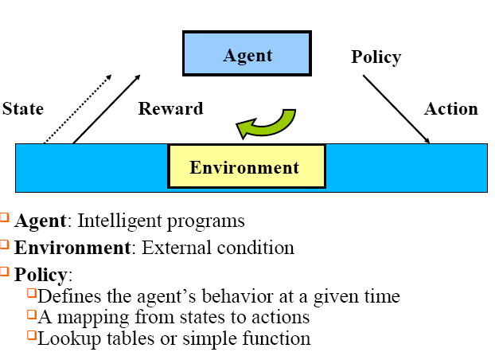
Element of reinforcement learning

Slide 70
Element of reinforcement learning
Reward function :
Defines the goal in an RL problem
Policy is altered to achieve this goal
Value function:
Reward function indicates what is good in an immediate sense while a value function specifies what is good in the long run.
Value of a state is the total amount of reward an agent can expect to accumulate over the future, starting form that state.
Model of the environment :
Predict mimic behavior of environment,
Used for planning & if Know current state and action then predict the resultant next state and next reward

Slide 71
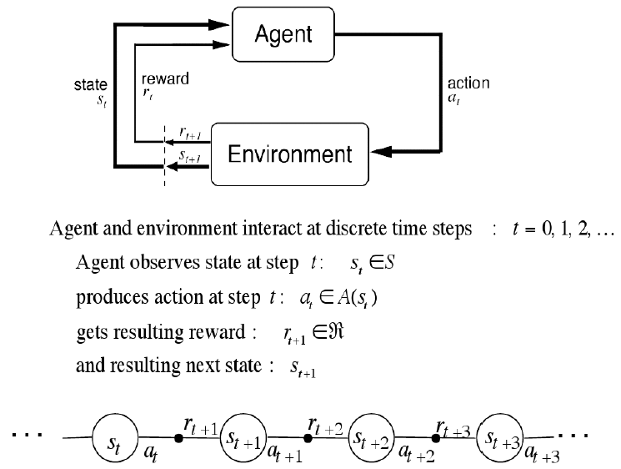
Agent- Environment Interface

Slide 72
Steps for Reinforcement Learning
1.The agent observes an input state
2. An action is determined by a decision making function (policy)
3. The action is performed
4. The agent receives a scalar reward or reinforcement from the environment
5. Information about the reward given for that state /action pair is recorded

Slide 73
Silent Features of Reinforcement Learning
Set of problems rather than a set of techniques
Without specifying how the task is to be achieved.
“RL as a tool” point of view:
RL is training by rewards and punishments.
Train tool for the computer learning.
The learning agent’s point of view:
RL is learning from trial and error with the world.
Eg. how much reward I much get if I get this.

Slide 74
Reinforcement Learning (Cont..)
Reinforcement Learning uses Evaluative Feedback
Purely Evaluative Feedback
Indicates how good the action taken is.
Not tell if it is the best or the worst action possible.
Basis of methods for function optimization.
Purely Instructive Feedback
Indicates the correct action to take, independently of
the action actually taken.
Eg: Supervised Learning
Associative and Non Associative:

Slide 75
Associative & Non Associative Tasks
Associative :
Situation Dependent
Mapping from situation to the actions that are best in that
situation
Non Associative:
Situation independent
No need for associating different action with different
situations.
Learner either tries to find a single best action when the task
is stationary, or tries to track the best action as it changes

Slide 76
Reinforcement Learning (Cont..)
Exploration and exploitation
Greedy action: Action chosen with greatest estimated value.
Greedy action: a case of Exploitation.
Non greedy action: a case of Exploration, as it enables us to improve estimate the non-greedy action's value.
N-armed bandit Problem:
We have to choose from n different options or actions.
We will choose the one with maximum reward.

